Slide 1


Lecture 20
Produced by Dr. Worldwide
Welcome to the 305
~
~

Slide 2

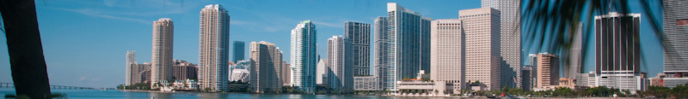
Solving in Excel
Algorithms for solving nonlinear programming models can be very complex
Most algorithms can only guarantee that they find a local optimizer rather than a global one
Excel Solver uses an algorithm called Generalized Reduced Gradient (GRG) to solve nonlinear problems
This algorithm is designed to find a local optimizer within a certain “tolerance” level, and it can sometimes get “stuck”
In problems not guaranteed to have a unique interior optimal solution, it is a good idea to run the GRG algorithm starting at several initial points

Slide 3
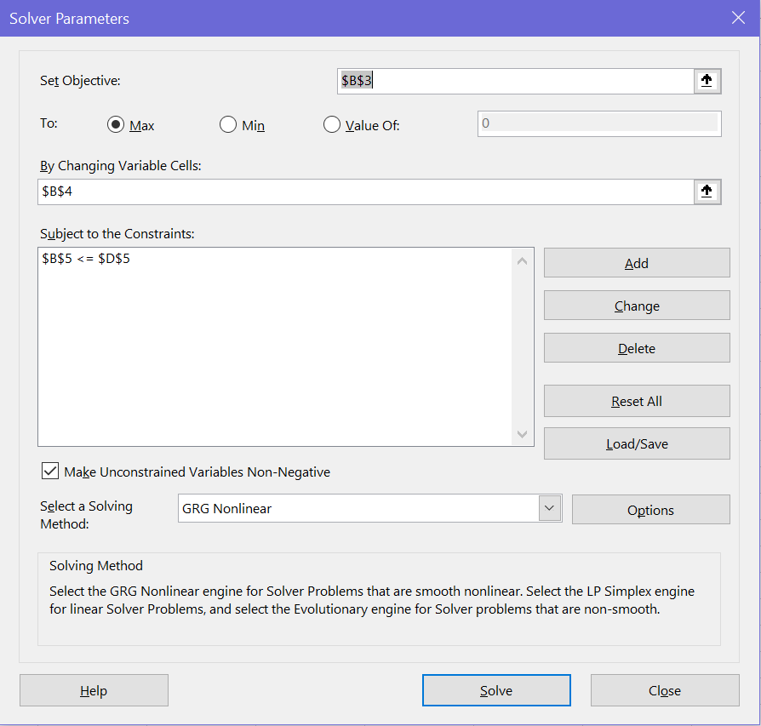
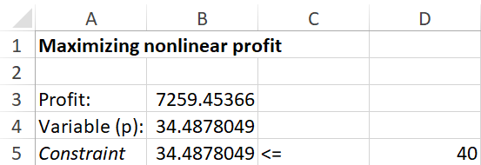
Solving in Excel
Download NonlinearProfit.xlsx from link Sheet 1 on course website
Inspect the spreadsheet and Solver
Solution is for price ceiling of $40
=1696.8*B4-24.6*B4^2-22000

Slide 4
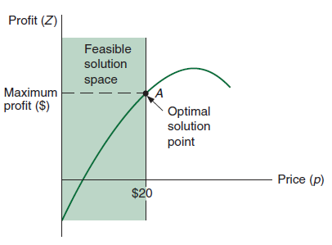
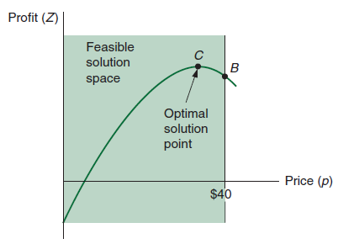
Solving in Excel
Q: What happens if you adjust the price ceiling to $20?
Q: Is your answer consistent with what we have previously seen?
Q: What happens if you completely drop the constraint?

Slide 5

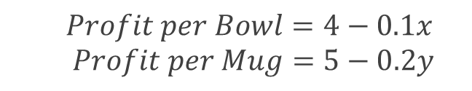
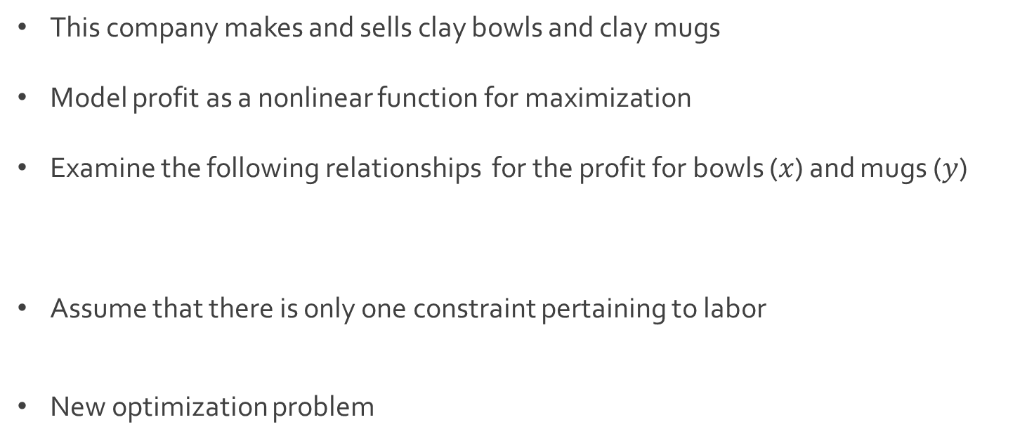
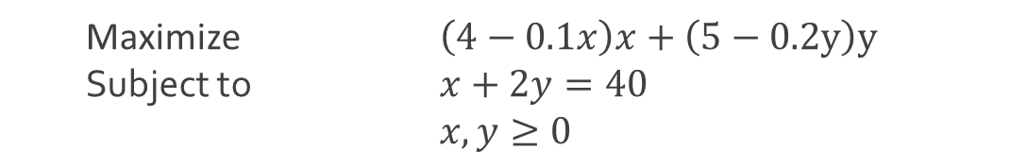
Ex: Beaver Creek Pottery
This company makes and sells clay bowls and clay mugs
Model profit as a nonlinear function for maximization
Examine the following relationships for the profit for bowls ($x$) and mugs ($y$)
Assume that there is only one constraint pertaining to labor
New optimization problem
$$Profit per Bowl=4−0.1x$$
$Profit per Mug=5−0.2y$
$$x+2y=40$$
Maximize $\left(4−0.1x\right)x+\left(5−0.2y\right)y$
Subject to $x+2y=40$
$x,y≥0$

Slide 6
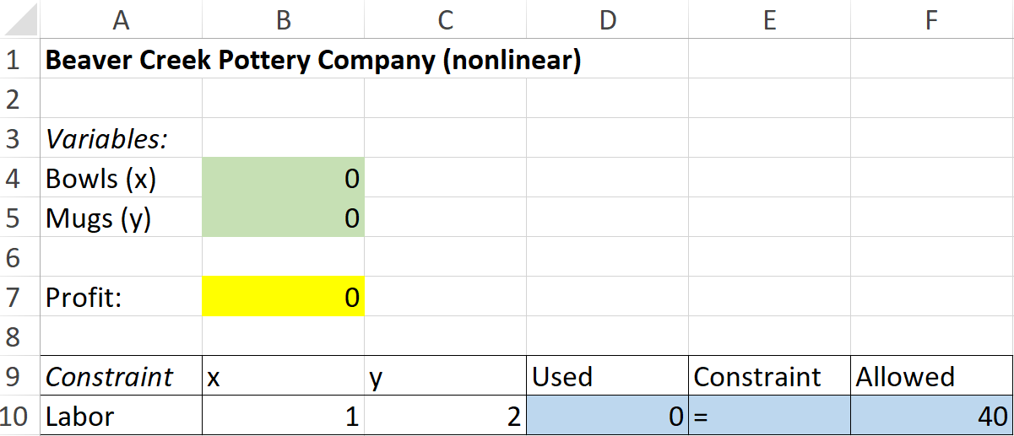
Ex: Beaver Creek Pottery
Download BeaverCreekNonlinear.xlsx from link Sheet 2 on course website
Inspect the spreadsheet and the nonlinear objective function
=(4-0.1*B4)*B4+(5-0.2*B5)*B5

Slide 7
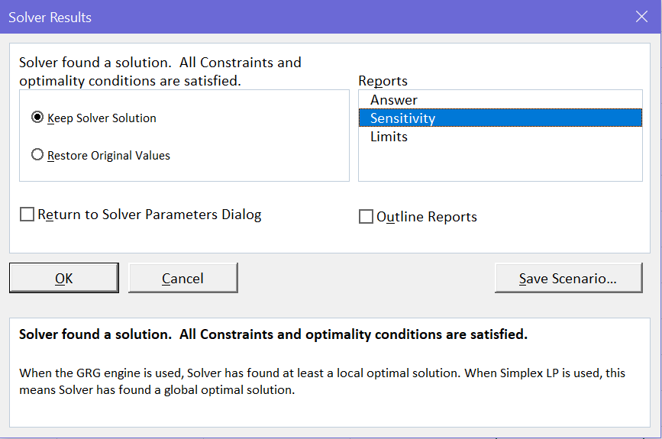
Ex: Beaver Creek Pottery
Run Excel Solver using algorithm Simplex LP and observe what happens
Run Excel Solver using GRG Nonlinear and select the sensitivity report

Slide 8
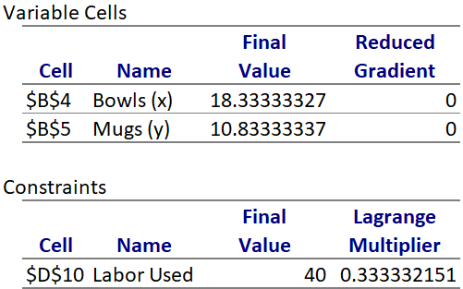
Ex: Beaver Creek Pottery
Solution is to produce 18.3 bowls and 10.8 mugs for a profit of $70.42
Inspect the sensitivity report
The Lagrange multiplier is analogous to the shadow price from before

Slide 9

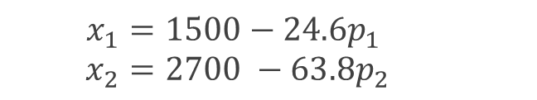
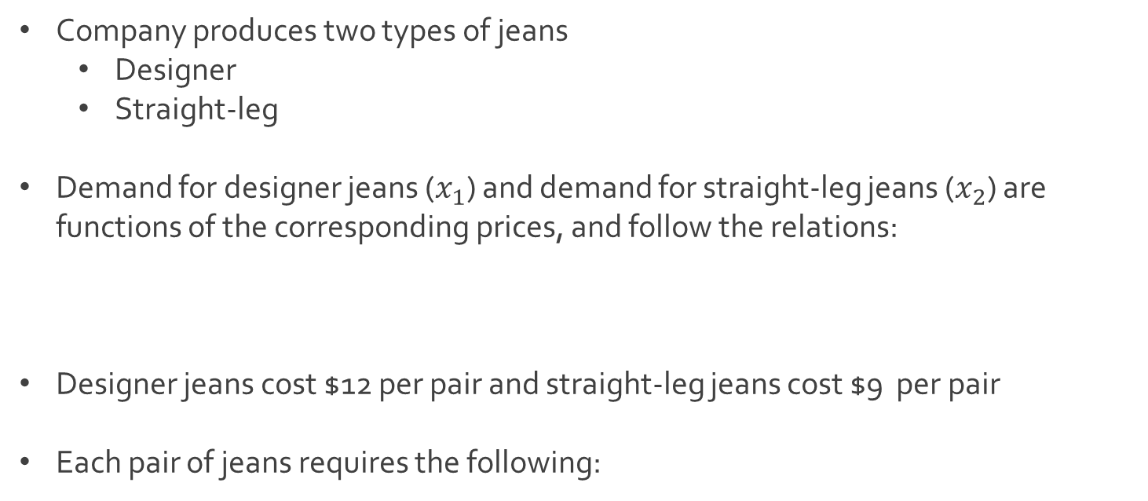
Ex: Western Clothing
Company produces two types of jeans
Designer
Straight-leg
Demand for designer jeans ($x_{1}$) and demand for straight-leg jeans ($x_{2}$) are functions of the corresponding prices, and follow the relations:
Designer jeans cost $12 per pair and straight-leg jeans cost $9 per pair
Each pair of jeans requires the following:
$$x_{1}=1500−24.6p_{1}$$
$$x_{2}=2700 −63.8p_{2}$$

Slide 10
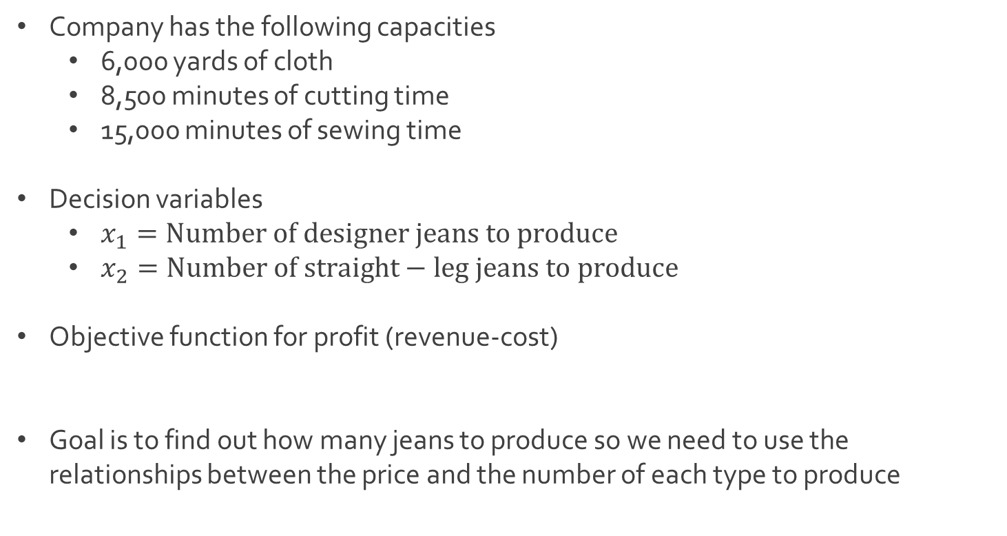
Ex: Western Clothing
Company has the following capacities
6,000 yards of cloth
8,500 minutes of cutting time
15,000 minutes of sewing time
Decision variables
$x_{1}=Number of designer jeans to produce$
$x_{2}=Number of straight−leg jeans to produce$
Objective function for profit (revenue-cost)
Goal is to find out how many jeans to produce so we need to use the relationships between the price and the number of each type to produce
$Z={(p}_{1}x_{1}+p_{2}x_{2})−\left(12x_{1}+9x_{2}\right)=\left(p_{1}−12\right)x_{1}+\left(p_{2}−9\right)x_{2}$

Slide 11

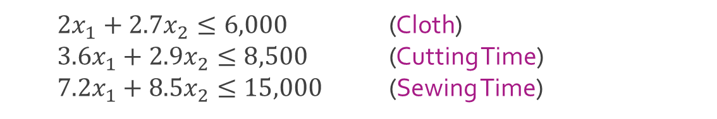

Ex: Western Clothing
Updated objective function for profit
Constraints based on limited resources
Nonnegativity constraints
Download WesternClothing.xlsx from link Sheet 3 on course website
$Z=\left(p_{1}−12\right)x_{1}+\left(p_{2}−9\right)x_{2}$
$=\left(\frac{1500−x_{1}}{24.6}−12\right)x_{1}+\left(\frac{2700−x_{2}}{63.8}−9\right)x_{2}$
$2x_{1}+2.7x_{2}≤6,000$ (Cloth)
$3.6x_{1}+2.9x_{2}≤8,500$ (Cutting Time)
$7.2x_{1}+8.5x_{2}≤15,000$ (Sewing Time)
$$x_{1}≥0 and integer \left(if possible\right)$$
$$x_{2}≥0 and integer \left(if possible\right)$$

Slide 12
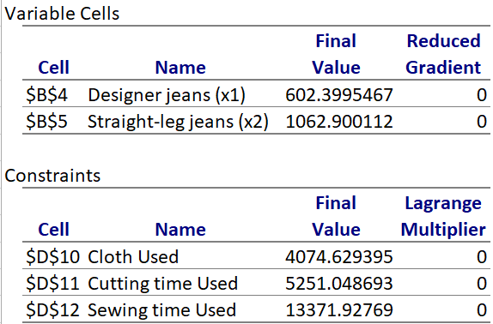
Ex: Western Clothing
Run Excel Solver
Add integer constraints and run Excel Solver (Sensitivity not available)

Slide 13
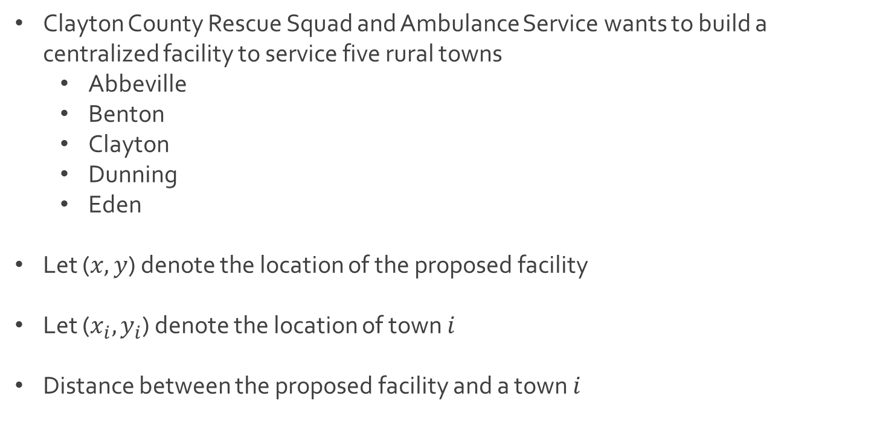
Ex: Facility Location
Clayton County Rescue Squad and Ambulance Service wants to build a centralized facility to service five rural towns
Abbeville
Benton
Clayton
Dunning
Eden
Let ($x,y$) denote the location of the proposed facility
Let ($x_{i},y_{i}$) denote the location of town $i$
Distance between the proposed facility and a town $i$
$d_{i}=\sqrt{{\left(x_{i}−x\right)}^{2}+{\left(y_{i}−y\right)}^{2}}$

Slide 14
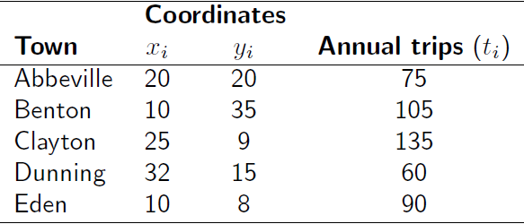
Ex: Facility Location
Town locations and number of annual trips are given below
Two ideas to consider
The facility should be placed closed to the center of all these towns
The facility should be placed closed to towns that are visited more often

Slide 15

Ex: Facility Location
Q: In which location should we place the facility that minimizes the distance to each of the towns, prioritizing those that are visited more often?
Nonlinear program (Unconstrained or constrained)
Download FacilityLocation.xlsx from link Sheet 4 on course website
Run Excel Solver both with and without positive constraint
Q: Did going from constrained to unconstrained get you an error?
Minimize $∑d_{i}t_{i}=∑t_{i}\sqrt{{\left(x_{i}−x\right)}^{2}+{\left(y_{i}−y\right)}^{2}}$
Subject to $x,y≥0$
Is this necessary?

Slide 16




The End
Dale

